Slide 1




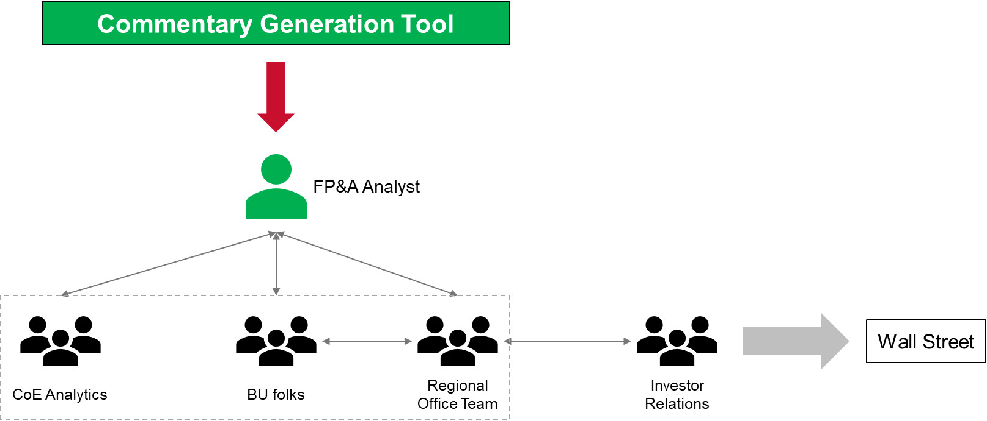



Automated Financial Commentary Generation
Utkarsh Chaturvedi | Supervised by Prof. Teo Thompson
Business Context:
Analysts on floor manually write financial commentaries every month, making decisions on when, what and how to convey information to business leaders. Automating the mundane aspects of this process can improve process efficiency
Pain-Points
Number Crunching
Art of Writing
Collaborations
Quick Insight Generation
Solution Flow:
Analyse past language for replication
‘Realise’ commentary
Build a front-end for ease of usage
Use an array of techniques like NLTK & word2vec to understand language
Study and implement the best technique to generate the language
Web-based app built using Dash for ease-of-use and flexibility to user
Solution Implementation:
Impact:
Time Saver
Improved Quality & Consistency
Scope for analytics engine

